Slide 1
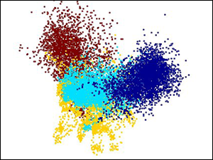
Decision Tree

Slide 2
Decision Tree Learning – Pictorial View
The Task
Given: collection of examples (x,f(x))
Return: a function h (hypothesis) that approximates f
h is a decision tree
Input: an object or situation described by a set of attributes (or features)
Output: a “decision” – the predicted output value for the input
The input attributes and the output can be discrete or continuous.

Slide 3
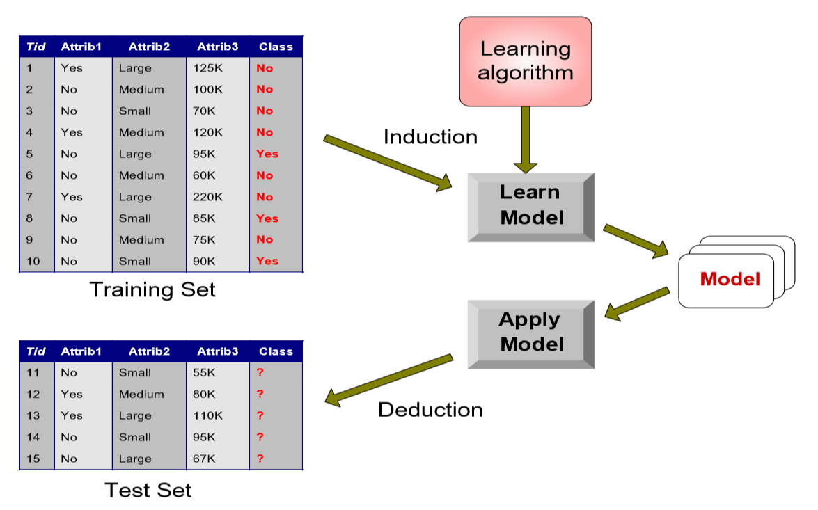
Decision Tree Learning – Pictorial View

Slide 4
Sample Applications
Predicting tumor cells as benign or malignant
Classifying credit card transactions as legitimate or fraudulent
Classifying secondary structures of protein as alpha-helix, beta-sheet, or random coil
Categorizing news stories as finance, weather, entertainment, sports, etc

Slide 5
Classification vs Clustering
Supervised learning (classification) – Supervision: The training data (observations, measurements, etc.) are accompanied by labels indicating the class of the observations – New data is classified based on the training set
Unsupervised learning (clustering) – The class labels of training data is unknown – Given a set of measurements, observations, etc. with the aim of establishing the existence of classes or clusters in the data

Slide 6
Classification vs Regression
Supervised Learning
– Classification
• Response Variable (class) has only two categories
• Response Variable (class) has multiple categories
• E.g., CORRECT/WRONG (sometimes expressed as 0,1)
– Regression
• Response Variable is continuous
• E.g., Stock price of MSFT tomorrow

Slide 7
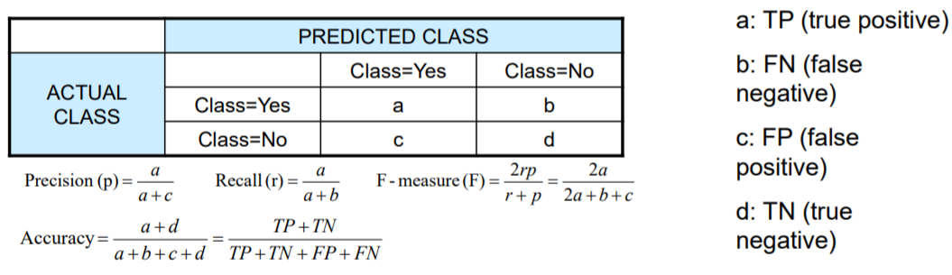
Evaluation Metrics for Classification
Focus on the predictive capability of a model
Rather than how fast it takes to classify or build models, scalability, etc.
Confusion Matrix

